Slide 1
CUSTOMER RELATIONSHIP MANAGEMENT
CONCEPTS AND TECHNOLOGIES
Chapter 13
Information technology for CRM

Slide 2
Origins of CRM technology
CRM has evolved from a range of stand-alone technologies including call centres, sales force automation systems, and customer information files (CIF), some of which date back to the 1970s and earlier.
In the late 1980s, several organisations attempted to consolidate some of these disparate technologies.
The customer started to be recognised as a single entity across all customer-facing departments, leading to the idea of a “single view of the customer”.

Slide 3
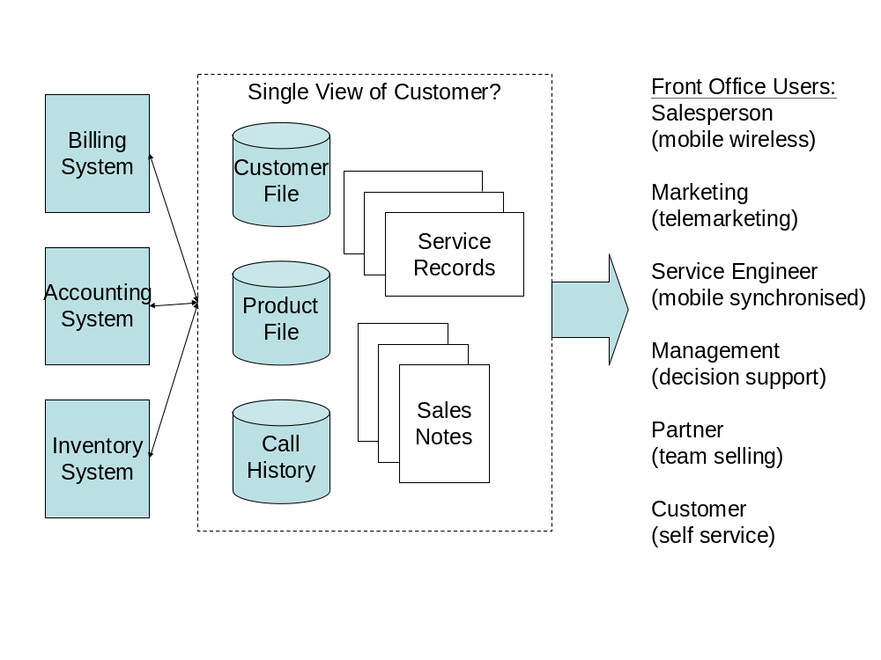
Single view of the customer in the front office

Slide 4






The challenge of multiple channels
Channel
Partner
Marketing
Warehouse
Sales
Finance
Customer
Service

Slide 5





Customer expectation: consistent dialogue
Marketing
Channel
Partner
Warehouse
Customer
Sales
Finance
Service

Slide 6
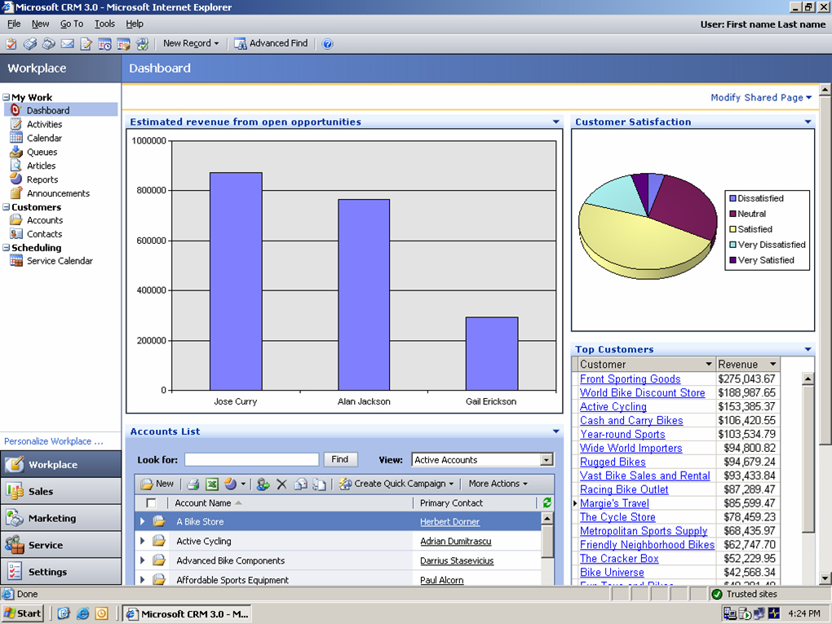
Microsoft CRM web interface

Slide 7
The CRM technology challenge
CRM must be flexible enough to stay in touch with a changing audience (the customer).
CRM must satisfy the different requirements of different industries
CRM must be accessible to external stakeholders and mobile professionals such as salespeople and field technicians.
CRM must operate over any communication channel
CRM must integrate with other systems to provide a single view of, and for, the customer.
CRM must be implemented in such a way that appropriate work processes and skills are deployed

Slide 8
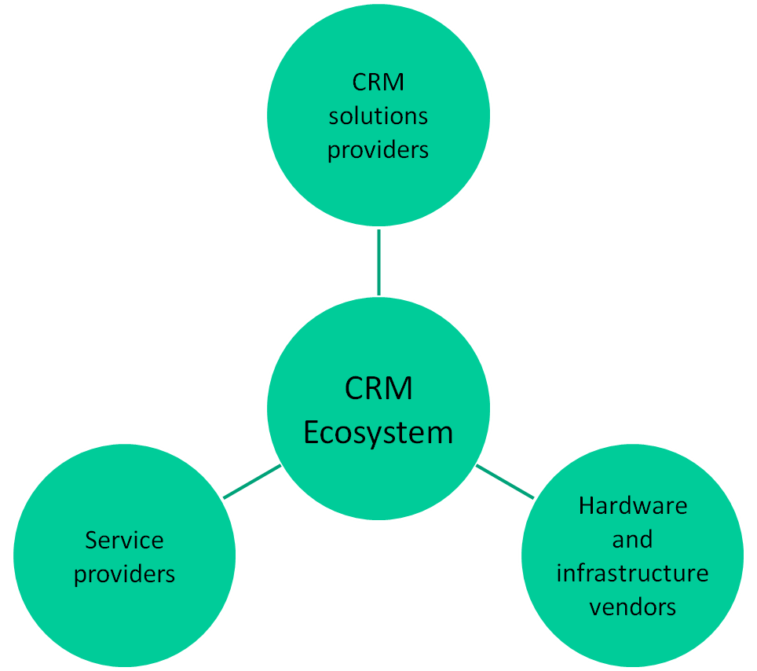
The CRM eco-system

Slide 9
Enterprise CRM suites
Enterprise CRM suites
Amdocs CRM
Chordiant Cx
Onyx CRM
Oracle’s E-Business Suite CRM
Oracle’s Siebel CRM
Oracle’s PeopleSoft CRM
Infor CRM E.piphany
Pegasystems Customer Process Manager
mySAP CRM

Slide 10
Midmarket CRM suites
Midmarket CRM suites
Entellium
GoldMine Corporate Edition
Maximizer Enterprise
Microsoft Dynamics CRM
NetSuite
Oracle’s Siebel CRM Professional Edition
Oracle’s Siebel CRM On Demand
Pivotal CRM
RightNow
Sugar Enterprise
SageCRM
salesforce.com
Soffront CRM Suite

Slide 11
CRM specialty tools
Analytics tools | Customer service tools
SAS | ATG
SPSS | Applix
Teradata | eGain
 | Graham Technologies
Customer data management tools | KANA
Dun & Bradstreet | KNOVA
Initiate | Unipress
Purisma
Siperian | Marketing automation tools
VisionWare | Aprimo
 | Unica
Partner channel management and collaboration
BlueRoads | Sales force automation tools
Click Commerce | Sage Saleslogix
Comergent (Sterling Commerce) | Saratoga

Slide 12
CRM service providers
Service | Details | Examples of service providers
Strategy consulting | Consulting support for the formulation of customer strategy, contact strategy, channel strategy, CRM strategy. | McKinsey, Peppers and Rogers
Business consulting | Services around business process re-engineering, process improvement, and best practices for CRM. | Accenture, Bearing Point, CGEY
Application consulting | Design and development of application modifications, project management of software package implementation and training. | CRM solutions companies, Accenture, CGEY, Bearing Point, IBM
Technical consulting | Design and implementation of technical infrastructure, and integration of this infrastructure with the existing business processes and applications. | Unisys, IBM, Logica
Outsource service providers | Technology outsourcers and business process outsourcers. | EDS, IBM, CSC, Acxiom

Slide 13
Alignment of CRM technologies
Not all CRM applications sit squarely in front-office functions of marketing, sales, and service.
  some CRM modules focus on customers or products
    customer and product management applications offer a suite of dedicated functions and modules that sit across sales, marketing and service.
  companies that market, sell or service through channel partners use PRM (partner relationship management), rather than CRM, solutions.
  CRM analytics are often regarded as a separate suite of applications with specialist solutions and vendors

Slide 14
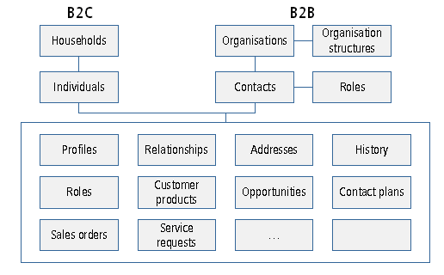
CRM components - customers

Slide 15
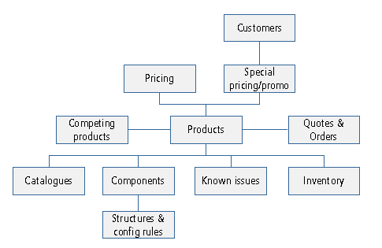
CRM components - products

Slide 16
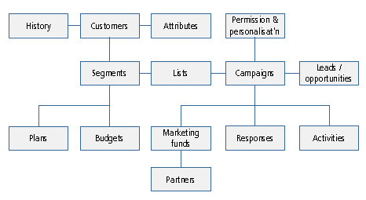
CRM components – marketing automation

Slide 17
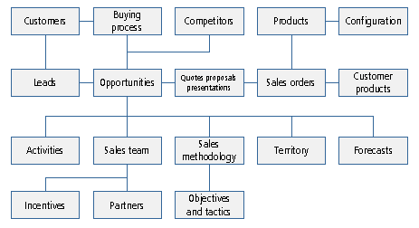
CRM components – sales force automation

Slide 18
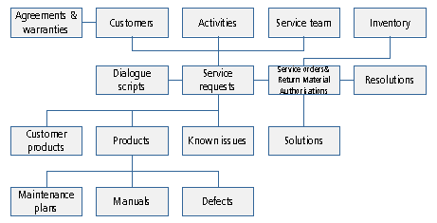
CRM components – service automation

Slide 19
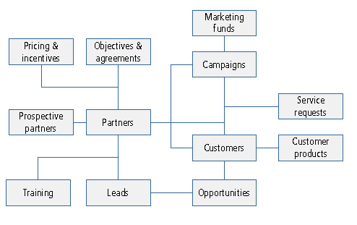
CRM components – partner relationship management

Slide 20
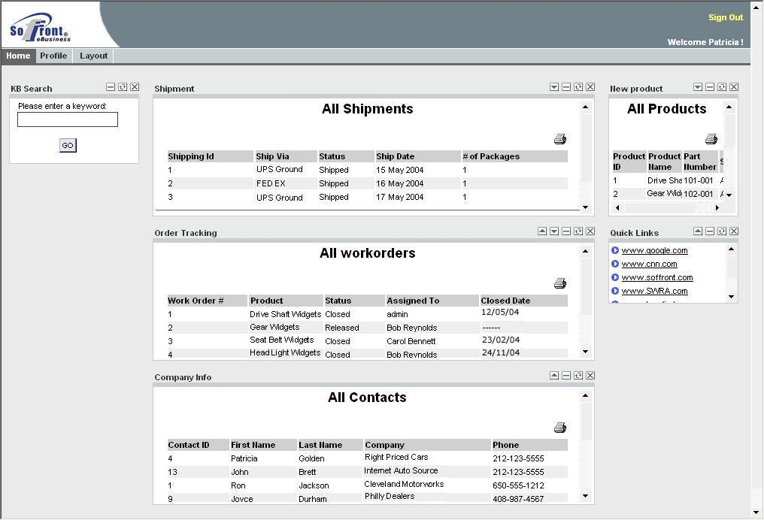
Example of partner portal

Slide 21
Three levels of CRM analytics
Standard reporting
Online analytical processing (OLAP)
Data mining.

Slide 22
Standard reporting
Reporting can be standardised (pre-defined), or query-based (ad-hoc).
  Standardised reports are typically integrated into CRM software applications, but often need customization to suit the needs of the organisation. Some customization of the report can be done when it is run, for example in selecting options or filtering criteria, but the end result is limited to what the report designers envisaged
  Query-based reporting presents the user with a selection of tools, which can then be used to construct a specific report.

Slide 23
OLAP
OLAP technologies allow warehoused data to be subjected to analysis and ad-hoc inquiry.
Warehoused data is stored in one or more star schema, allowing users to drill down into graphs and tables to analyse how a certain figure or problem may have arisen.

Slide 24
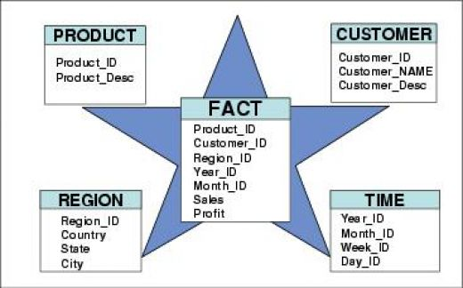
Star schema of data stored in a data warehouse

Slide 25
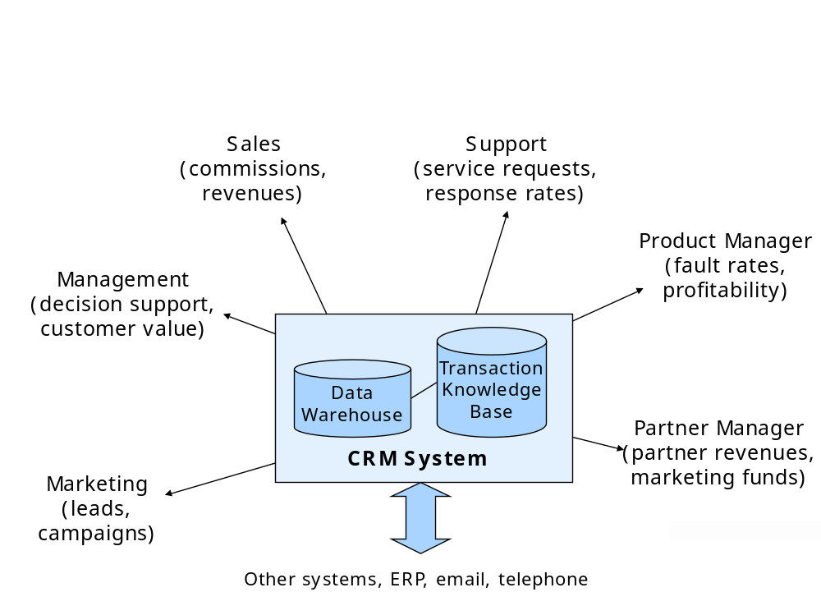
Users demand different reports using OLAP technology

Slide 26
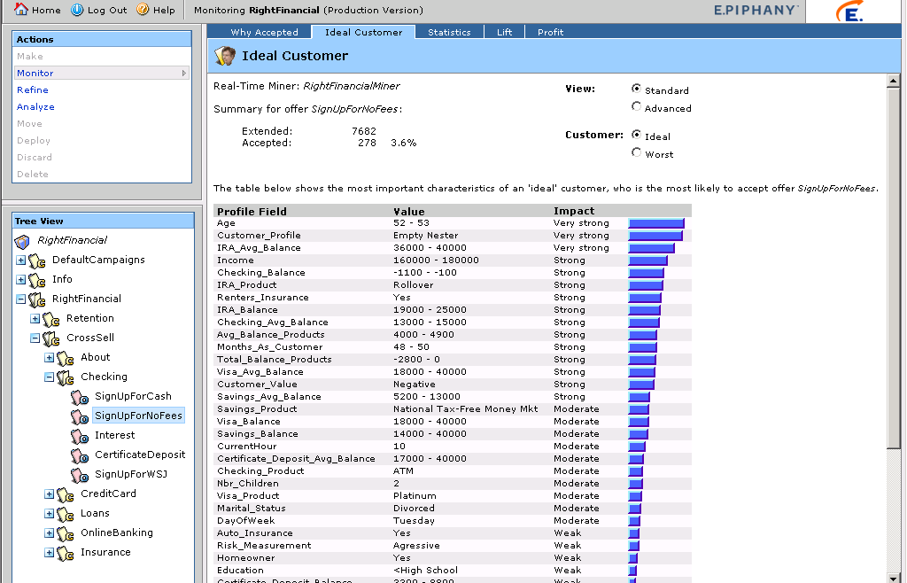
Real-time CRM analytics

Slide 27
Data mining
The data mining process seeks to identify patterns and relationships in the data, using selection, exploration and modelling processes.
The results include, for example, churn scoring (likelihood that the customer will leave), fraud detection, customer value scoring, and campaign effectiveness scoring.
A number of CRM vendors specialise in advanced analytical and data-mining applications

Slide 28
CRM architecture
A key consideration in effective CRM is the way in which the system is constructed, or the “architecture”. Unlike purely internal systems, CRM systems must be able to operate in the office, out of the office, and over the web. They must tie together multiple communication channels each using very different technologies (web, email, telephone), and they must perform well enough, and be flexible enough, to suit a constantly changing, potentially growing user community.

Slide 29
The two major challenges of multi-channel CRM
multiple communication technology channels
multiple organisational touch-points

Slide 30
Multiple communication channels
Customers can choose to communicate with an organisation by telephone, email, web chat or face-to-face
They expect a consistent dialogue
CRM technology lets companies create and track a consistent dialogue that reflects the value of the customer.

Slide 31
Multiple organisational touch-points
Customers communicate with different people in an organisation.
  Marketing sends out customer offers, sales reps call to negotiate terms and the customer calls the service desk for assistance.
The marketing offer should be visible in order for the customer service agent to treat the customer correctly.
Channel partners must be included in the communication loop if channel conflict over pricing, leads, and commissions is to be avoided.

Slide 32
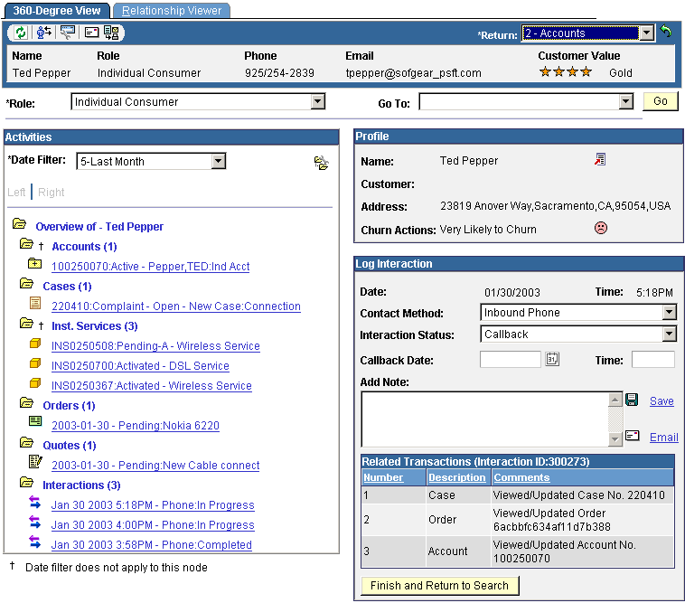
Multi-channel view of the customer

Slide 33
Technologies for mobile professionals
Mobile (synchronised)
  Mobile synchronised solutions include a handheld or laptop device, with a small resident database that is a replica of the particular individual’s information in the main CRM system.
  These systems are not “online” or permanently connected, but they rely on sophisticated synchronisation technology
Wireless (online)
  Wireless devices are connected to the main system using a wireless connection such as a mobile phone unit or card. Technologies such as Bluetooth have enhanced user experience.

Slide 34
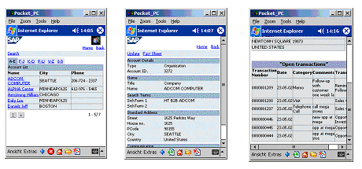
Sample handheld screenviews

Slide 35
Integration
Specialist integration middleware providers such as Webmethods, IBM, SeeBeyond, and Tibco play an essential role in large scale, complex CRM projects.
The integration challenge is largely a function of the complexity of the applications environment, and the need for timeliness of information transfer.
There are two main types of integration: batch and real time.

Slide 36
Batch and real-time integration
Batch integration
Batch processing stores information in a file or batch, then moves the information across the interface into the destination system in one go.
Real-time integration
RTI takes place immediately. For example once a customer record is updated in one system, the change is immediately reflected in the destination system

Slide 37
Four integration challenges 1
Application integration
  Application integration ties together the CRM system and other business systems such as accounting, billing, inventory and human resources.
Telephony integration
  Telephony integration ties the CRM application in to the telephone system, allowing inbound calls to be routed to the right person based on caller profile, and outbound calls to be automatically made from the call centre desktop.

Slide 38
Four integration challenges 2
Email integration
  Email integration can involve both the generation of emails as a result of an internal workflow process (e.g., once an order is ready for shipment, automatically email the customer to advise dispatch details), and automated email routing and response
Web integration
  Most Western business have a web site, and this web site contains large amounts of content that is duplicated in the CRM system (customer registration details, solution knowledge base, product information, price lists, etc).

Slide 39
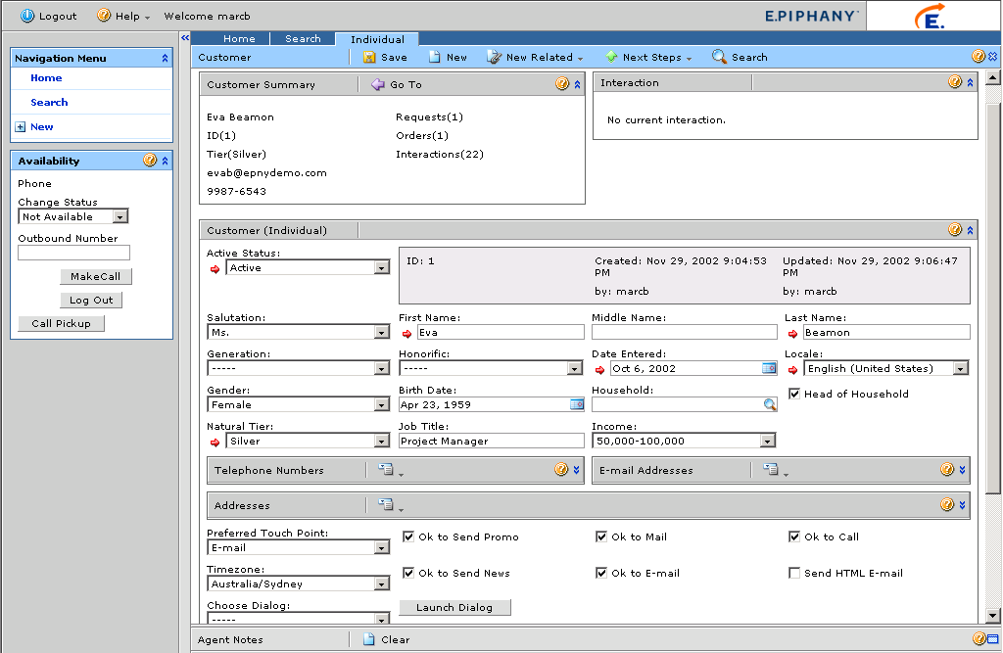
Call centre service application

Slide 40
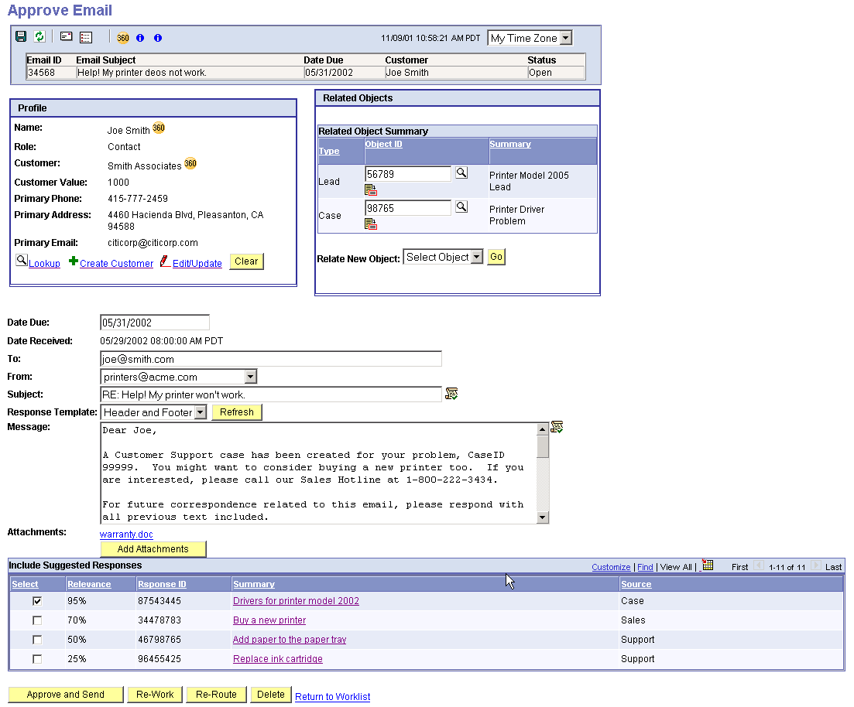
Email response screenshot

Slide 41
Knowledge management definition
Knowledge management is the organizational practice of consciously gathering, organizing, storing, interpreting, distributing and judiciously applying that knowledge to fulfill the mission of the organization.

Slide 42
Automated workflow
Many customer-related processes can be predefined and automated in modern CRM applications, meaning that business rules that are critical to the success of sales, marketing and service no longer need to be manually managed.
Workflow technologies can also be programmed to monitor for predefined conditions.

Slide 43
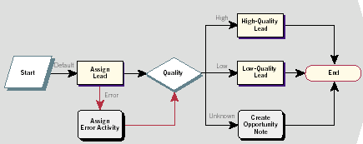
Lead assignment workflow

Slide 44
Examples of automated workflow engineering
Service enquiry
Email response
Lead assignment
Dialogue scripting
Log-in navigation
System integration

